Slide 1








A 2-days National Level Hackathon on
AI IN EDUCATION
THEME : EDUCATION
Team Name : Spectrabyte
Leader : Bhavika Ajwani
College : Sagar Institute of Science and Technology (SISTec)
Location : Gandhi Nagar, Bhopal
Date of Submission : 5-9-2025
www.samadhan.sistec.ac.in/

Slide 2


AREA OVERVIEW
Education plays a fundamental role in shaping individuals, empowering societies, and driving economic and social progress. The field of education constantly evolves with technological advancements, introducing innovative tools and methodologies to enhance learning. Modern education emphasizes critical thinking, creativity, digital literacy, and personalized learning experiences to prepare individuals for the challenges of a rapidly changing world.
AI is transforming education by making it personalized, interactive, and scalable. Traditional education often treats every learner the same, but AI can adapt to each student’s pace, style, and strengths. It also reduces the burden on teachers by automating repetitive tasks and creating engaging learning experiences.
IMPORTANCE OF AREA
Education faces challenges such as a lack of personalized learning, limited access to resources, and delays in doubt resolution. These issues highlight the need for innovative solutions that can address these problems effectively. EduAnimate is an AI powered animated learning platform motivated by a desire to make education more fun, accessible, and effortless, while reducing the workload on teachers and increasing curiosity among students.

Slide 3
Potential Challenges and Opportunities
Challenges or Pain Points
Lack of Personalized Learning
Static and Text-Heavy Learning Materials
Low Engagement
Teacher/Educator/Instructor Workload
Cost Constraints
Opportunities for EduAnimate
Adaptive Animated Content
24/7 Availability and Device Compatibility
Collaborative Learning
Automated Content Creation
Scalability and Affordable Access

Slide 4
Preliminary Solution Concept
Objective: Our aim is to transform traditional, static learning materials into personalized, engaging, and collaborative AI-powered animated experiences that reduce teacher workload and boost student understanding.
Personalized
Learning Assistance
AI adapts lessons to each student’s pace, style, and understanding
level, ensuring individualized
support.
Provide Instant
Support
Offer 24/7 assistance to students, reducing wait times and frustration.
Act as a virtual tutor, resolving doubts in real time.
Boost Engagement
& Motivation
AI makes learning interactive and fun through animations, quizzes, and gamified experiences, keeping
students curious and
motivated.

Slide 5
Key Features and Functionalities
Personalized
Interactions
1. Adapts video explanations to student level (basic, intermediate, advanced).
2. Offers custom learning paths based on strengths, weaknesses,
and progress history.
Automated Task
Handling
1. Instantly converts text, PDFs, or lectures into animated explainer videos, saving teacher preparation time.
2. Automates progress tracking and reporting, reducing administrative workload for educators.
24/7 Assistance
1. Students can generate animated lessons or clarifications anytime and anywhere with ease.
2. AI answers doubts in real time, ensuring continuous learning support.
Interactive Learning Support
1. Provide quizzes, flashcards, and practice tests to aid learning.
2. Provides collaborative study rooms where students can chat, annotate, and solve problems together.

Slide 6
Target Users and Expected Use Cases
TARGET USERS
Students/Learners
Instant access to study materials and resources.
Engaging, animated explanations of concepts.
Educators (Teachers/Trainers)
Quick AI-generated teaching material.
Tools to deliver interactive content and quizzes.
Educational Institutions (Schools, colleges, universities, and online learning platforms)
Enhance student engagement and satisfaction.
Improve accessibility and inclusivity.
Optimize resource utilization by automating support systems.
EXPECTED USE CASES
Doubt Resolution: Converts provided content into animated explainer videos, making heavy study material simple and visual.
Saves Time & Effort: Automates lesson preparation, video creation, and progress tracking so teachers and students focus more on learning than routine tasks.
Interactive Learning: Adds interactive elements like quizzes, polls and discussions inside videos.
24/7 Availability: Provides continuous availability for students to learn and revise whenever they need.

Slide 7
Data Requirements and Privacy Considerations
Data Requirements
User Profiles
Purpose: Personalize interactions and learning.
Academic Data
Purpose: Track progress, identify strengths, weaknesses, and suggest personalized study plans.
Behavioral Data
Purpose: Improve performance, identifying common queries, and enhance user experience.
Resource Data
Purpose: Provide content and guidance to users in a structured way.
Administrative Data
Purpose: Automate administrative tasks.
Data Gathering and Processing
Input Methods: Users provide data directly through interactions with the platform.
Educators upload academic records and resources.
Behavioral data is gathered automatically through users usage logs.
Processing: Natural Language Processing (NLP) analyzes user input to understand queries and generate responses.
Database Integration stores and retrieves user profiles, academic data, and behavioral patterns.
Output: Personalized responses, progress reports, recommendations, and notifications.
Encryption
Data Retention Policies
Backup and Recovery

Slide 8


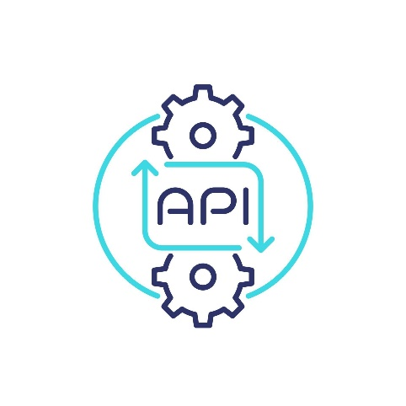








AI Technologies and Methods
TECH STACK
Core Programming Language : Python
Versatile, beginner-friendly, and supports AI, NLP, and backend tasks.
2. Backend Framework : FastAPI
Lightweight, fast, and ideal for building APIs. It supports modern Python features like type hints for robust and clean code.
3. Natural Language Processing (NLP) :
SpaCy: Efficient library for NLP tasks like tokenization, intent recognition, and entity extraction.
Transformers (Hugging Face): Provides pre-trained language models (e.g., GPT, BERT) for advanced conversational capabilities.
Database :
MySQL: Relational database to store user profiles, interaction logs, and academic data.
SQLAlchemy (Python ORM): Simplifies database interactions and integrates seamlessly with MySQL.
Deployment : Heroku
Easy-to-use platform for deploying Python applications with MySQL support.
6. Frontend : HTML, CSS, JavaScript
Basic tools to create a simple web-based interface for the chatbot.
Why us?
Ease of Use
Efficiency
Cost-Effectiveness

Slide 9
Implementation Approach
Objective: To develop a scalable and interactive educational platform with features like quizzes, visual aids, doubt resolution, and progress tracking.
Key Technologies
Backend: Python, FastAPI
NLP: Spacy, Transformers
Database: MySQL/SQLite (SQLAlchemy)
Frontend: HTML, CSS, JavaScript
Deployment: Heroku
Development Phases
Plan architecture and features (1 Week)
Backend and API development (2 Weeks)
Frontend integration (2 Weeks)
NLP module setup (2 Weeks)
Testing and debugging (1 Week)
Deployment on Heroku (1 Week)
Outcome: EduAnimate – A platform enabling personalized and interactive learning experiences.

Slide 10
Evaluation Metrics
Anticipated Impact
EduAnimate revolutionizes learning by turning static content into personalized, animated experiences. It boosts student engagement, saves teachers time, and enables collaborative, cross-device education. With real-time tracking and AI-driven support, it makes learning more accessible, efficient, and fun.
Key Performance Indicators (KPIs)
Response Time: Average time taken to respond to user queries.
Accuracy: Percentage of correct and relevant content provided.
User Engagement: Metrics like session duration, number of interactions per video, and quiz participation.
Retention Rate: Percentage of returning users.
Error Rate: Frequency of incorrect responses or system failures.

